Slide 1
VIRTUAL GUARDIAN FOR NAVIGATING ADOLESCENCE WITH CONFIDENCE
DURGA K – 2021503015
SHOBIA TR – 2021503051
VINOTHINI R – 2021503569
VINITHA V - 2021503061

Slide 2
PROBLEM STATEMENT
Adolescent girls undergoing the critical phase of adolescence often lack dedicated resources addressing their unique challenges. Limited access to accurate information and support can result in confusion, anxiety, and a diminished sense of self-worth. Existing educational systems and societal pressures fail to adequately address their distinct needs, leaving them without a comprehensive and personalized guide to navigate physical changes, emotional shifts, and holistic well-being. The absence of such guidance negatively impacts their self-confidence and emotional resilience. There is a clear need for a solution that offers tailored support, accurate information, and a safe space for dialogue to empower teenage girls to navigate adolescence confidently and with improved well-being.

Slide 3
OBJECTIVE
Develop a web-based platform that educates users about menstrual health, provides nutritional guidance for different phases of the menstrual cycle, and offers strategies to manage emotional well-being.

Slide 4
SCOPE
The scope of the project encompasses the development and implementation of a comprehensive virtual companion platform specifically designed to empower and support adolescent girls as they navigate the challenges and transformations of adolescence. The project's primary focus is to create a virtual guardian that acts as a reliable mentor, guide, and source of valuable information for teen girls.

Slide 5
FUNCTIONAL REQUIREMENTS
User Authentication and Profiles:
Ensure a secure and private environment where adolescent girls can create and manage their profiles, allowing for a personalized experience.
Menstrual Health Education:
Offer accurate and age-appropriate information about menstrual health to help girls understand and manage this aspect of their development confidently.
Nutritional Guidance:
Provide tailored nutritional advice to support healthy growth and development during adolescence, emphasizing the importance of balanced diets.
Emotional Balance Strategies:
Support emotional well-being by including resources for self-esteem, body image, and coping with emotional changes, fostering a positive experience for adolescent girls.

Slide 6
CONT…
Community Interaction:
Establish a supportive and safe community space where adolescent girls can connect with peers, share experiences, and seek advice in a positive environment.
Personalized Recommendations:
Utilize data and user input to offer personalized recommendations for activities, self-care practices, and lifestyle choices that align with their individual needs and preferences.
Notification System:
Implement a notification system to provide gentle reminders for important events, educational content, and self-care activities.
Dashboard and Analytics:
Offer a user-friendly dashboard that provides insights into their health and wellness journey, allowing them to track progress and access relevant information easily.

Slide 7
NON FUNCTIONAL REQUIREMENTS
User-Friendly Interface:
Make the app easy to use so that girls can navigate and enjoy it without any trouble.
Privacy and Data Security:
Keep everything private and secure so that girls' information is safe.
Scalability:
Make sure the app can grow and handle more users and features smoothly.
Portability:
Allow girls to use the app easily on different devices like phones and computers.

Slide 8

TECHNOLOGY USED
HTML
CSS
JAVASCRIPT
PHP

Slide 9
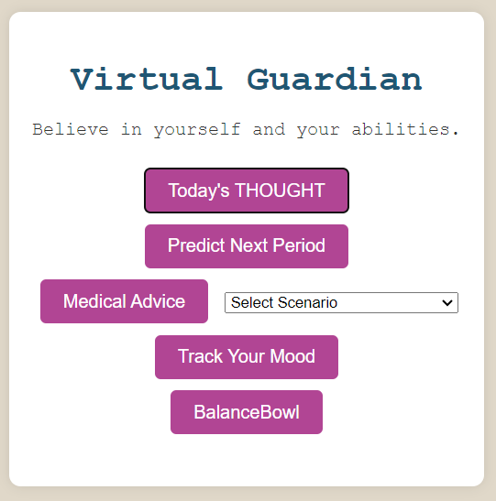
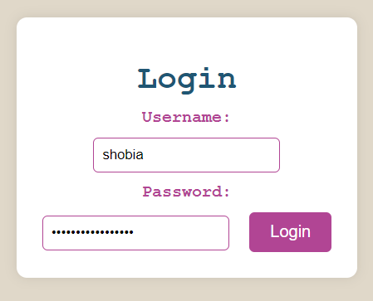
IMPLEMENTATION

Slide 10
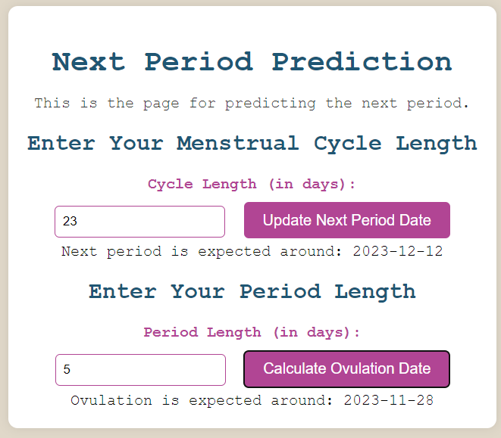
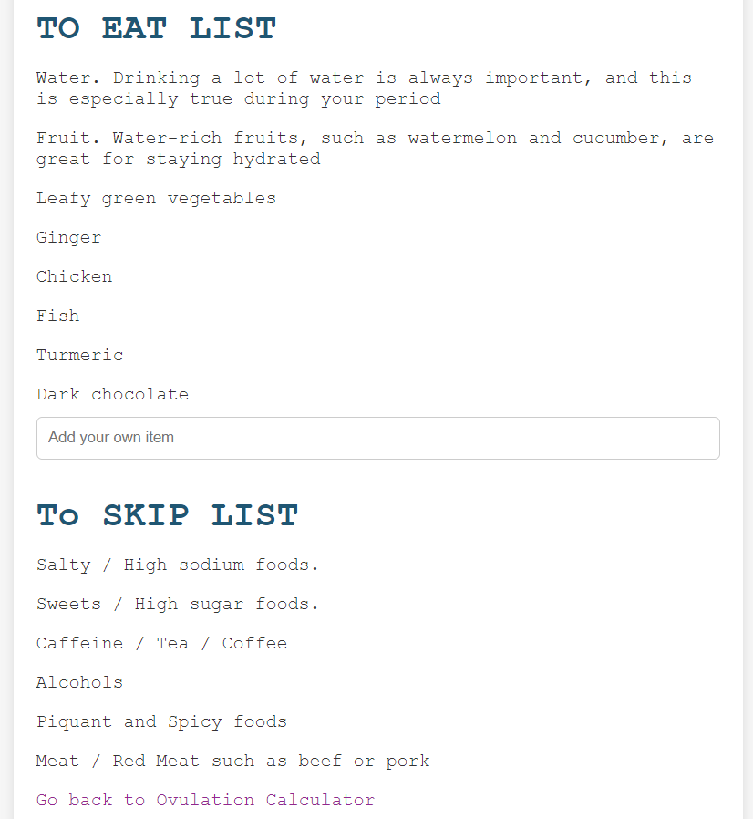
IMPLEMENTATION

Slide 11
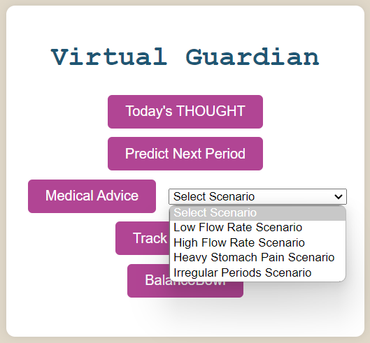
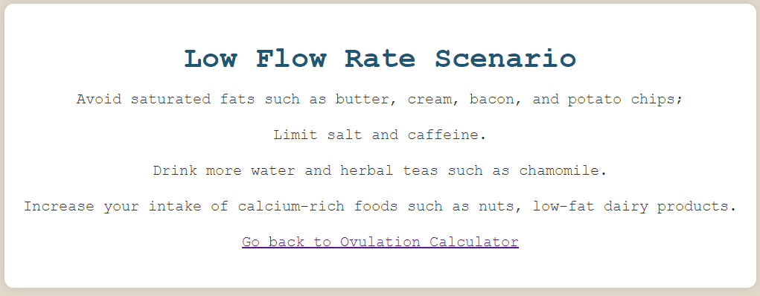
IMPLEMENTATION

Slide 12
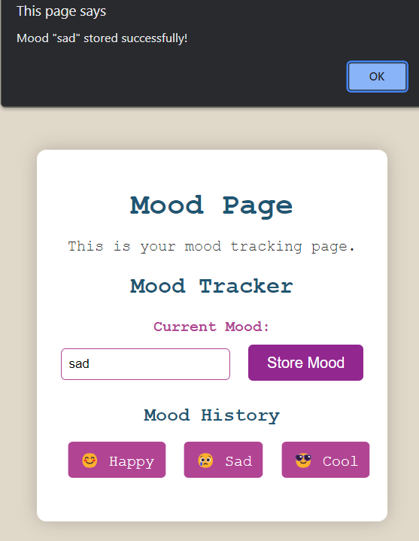
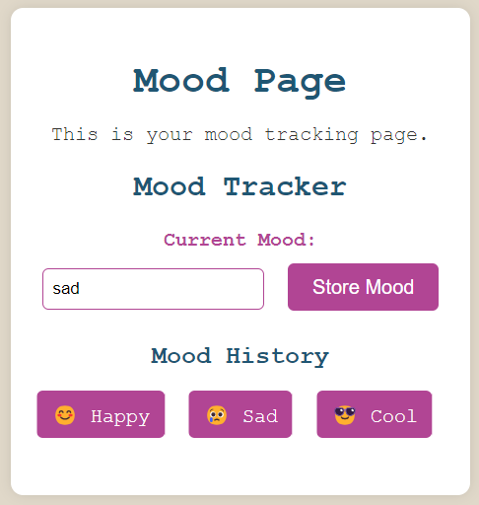
IMPLEMENTATION

Slide 13
REFERENCES
Lucky, Anne W. “Quantitative Documentation of a Premenstrual Flare of Facial Acne in Adult Women.” Archives of Dermatology, vol. 140, no. 4, Apr. 2004, pp. 423–24.
“Menstrual Cramps.” Mayo Clinic, 30 Apr. 2022, www.mayoclinic.org/diseases-conditions/menstrual-cramps/symptoms-causes/syc-20374938.
“Menstruation in Girls and Adolescents: Using the Menstrual Cycle as a Vital Sign.” The American College of Obstetricians and Gynecologists, www.acog.org/clinical/clinical-guidance/committee-opinion/articles/2015/12/menstruation-in-girls-and-adolescents-using-the-menstrual-cycle-as-a-vital-sign. Accessed 26 Sep. 2022.

